Slide 1
Software Engineering
Module 4
Introduction to Systems Engineering
Dr. Shai Koenig
Open University
Department of Computer Science

Slide 2

The Systems View
For most systems, products and projects - the software view should be preceded by a “systems view”.
The systems view deals with
  needs and objectives
  constraints
  system requirements
  system design
  planning and coordination
  testing

Slide 3




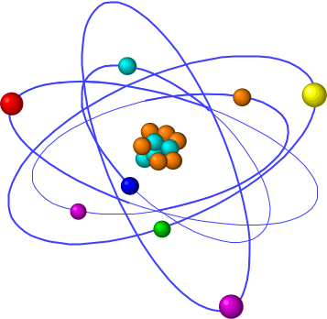
What is a system ?
collection of interacting elements
purposeful
provides
  service and/or
  outputs [materials, energy, information]
governed by “laws”
its use follows “procedures”
undergoes continuous change
natural vs. man-made
...

Slide 4

Man-made systems
There is nothing
  more difficult to plan
  more doubtful of success, nor
  more dangerous to manage
than the creation of a new system.
      Niccolo Machiavelli
      The Prince, 1513

Slide 5
Systems Engineering Activities
Define system objectives
Define operational concept
Perform feasibility studies
  technical
  economic
  operational
Specify System Requirements
Perform System Design
  identify components
  allocation of functionality, interfaces
  define internal interfaces
  verify performance
  explore alternative designs, select, justify
Coordinate development activities
  manage requirements
  manage design
  manage interfaces
Perform System Integration
  develop integration strategy
  integrate, coordinate
Perform System Testing
  plan
  execute
Delivery and Installation

Slide 6
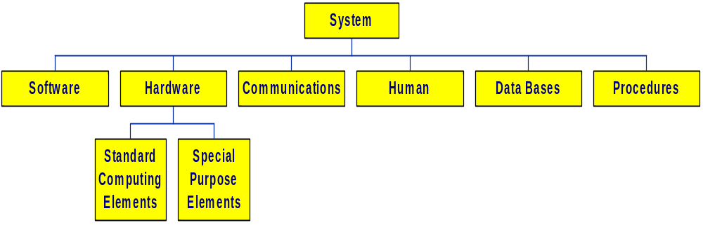
Elements of Computer-based Systems
Other System Elements
packaging [mechanical engineering]
product engineering
manufacturing
civil engineering
other systems

Slide 7
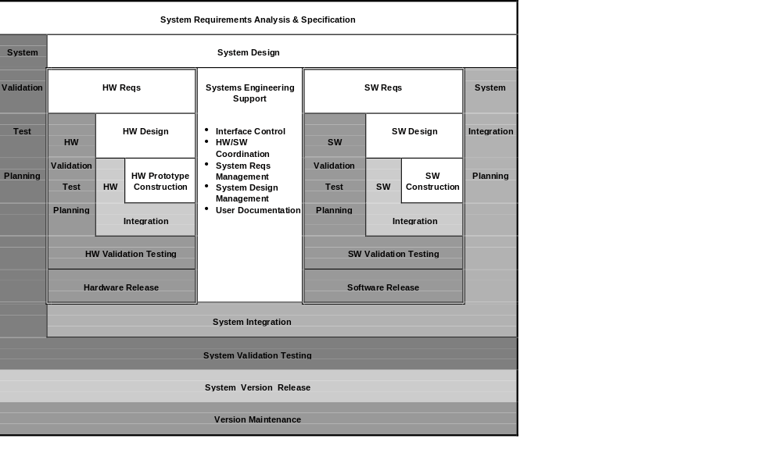
Key System Development Activities
Notes:
Notes
This slide presents a more comprehensive lifecycle showing the systems engineering, hardware engineering and software engineering processes, their key development activities and their interrelationships.

Slide 8
Documenting the systems engineering process
- The Systems Engineering Process Matrix
 | WORK-PRODUCTS · specifications · descriptions · drawings · source code - … | WORK-PRODUCT DEVELOPMENT PRATICES · procedures · standards · techniques · tools | SW QUALITY ASSURANCE PRACTICES · wp evaluations · process assessments · internal auditing - corrective action | WORK-PRODUCT CONTROL PRACTICES · document control · source control · version control · change control
Marketing Analysis & Requirements
System / subsystem Requirements
System / subsystem Design
System Documentation
System / subsystem Integration
System Testing
Release & Deployment

Slide 9
System Engineering - Summary
users
cost/schedule constraints
developers
customers
technology
marketing
legal requirements
objectives
feasibility
system
requirements
system
design
hardware
human
...
software

